Slide 1
Did the poor pay more? Income-related variations in diet and food quality among urban households in Sweden 1913–1914
Stefan Öberg, Unit for Economic History
Email: stefan.oberg@gu.se

Slide 2
Socioeconomic dimensions of diet and health during the 20th century: A longitudinal study
Based on primary materials from household budget surveys in Sweden in the early 20th century.
Create the LONGH Cohort by finding date and cause of death (and height, weight etc. for men) for the people living in the households participating in the surveys.
Funded by the Swedish Research Council, 2016–2019
+ Wallander postdoc scholarships from Jan Wallanders och Tom Hedelius Stiftelse

Slide 3
Did the poor pay more? Income-related variations in diet and food quality among urban households in Sweden 1913–1914
Study of ways used to economize on the food expenditure by urban households in early 20th century Sweden.
Tries to contribute to our knowledge about the dietary changes during the 20th century and their underlying mechanisms.

Slide 4
Previous research:
Mostly on developing countries or the USA
(Prais and Houthakker 1971, analyzing a 1937/38 survey from Britain is an exception).
Do the poor pay more for their food? (Aguiar and Hurst, 2007; Beatty, 2010; Broda, Leibtag and Weinstein, 2009)
– i.e. ‘poverty penalty’? (Mendoza 2011; Prahalad 2006).
Do stores in areas with different average levels of income charge different prices?
Do households with different levels of income consume different diets?
Do households shift there consumption of varieties within food categories as suggested by Bennett (1941; see also Grigg 1996)?
For example substituting other staples with wheat.

Slide 5
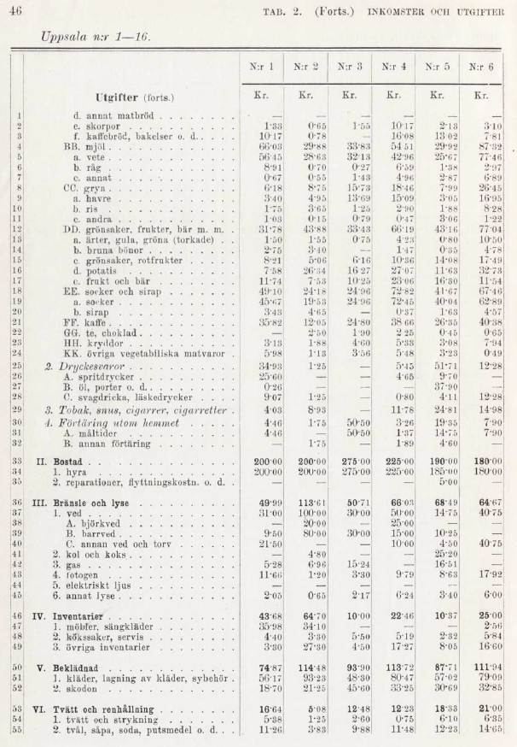
Data:
Survey of the cost of living and living conditions
908 households in 8 cities/towns
Carried out for a whole year, 1913–1914
Non-random, stratified sample of “typical” households (husband, wife and children)
Households recorded all incomes, expenditures and consumed quantities. (70% continued for the whole year!)
Data checked and summarized in tables that were published in a book (Socialstyrelsen 1919). The book included results for 908 out of 1355 households.

Slide 6
Diet:
Per person and week (approximate figures):
2 liters of potatoes
650 grams of flours (besides a lot of bread)
4 liters of milk (unskimmed and skimmed combined)
40 grams of meat
2 eggs
250 grams butter and margarine (together)
400 grams sugar

Slide 7
Close association
between household
income and total
food expenditure,
r = +0.90

Slide 8
= The Engel curve

Slide 9
The poorer households might very well have had to reduce the
quantity of food consumed.
We have not yet established which conversion factors we should use to estimate the energy and nutrient equivalents of the foods and beverages.
We do not study the quantity of food consumed but rather the
quality.
- changes of the ‘quality’ of food items and beverages bought
- changes of the dietary composition

Slide 10
Research questions:
Did households with different levels of income (on average)…
spend different amounts per unit for the foods and beverages they bought?
consume diets with a different composition?
Can we see indications of a shift within varieties of staples consumed (as proposed by Bennett)?

Slide 11
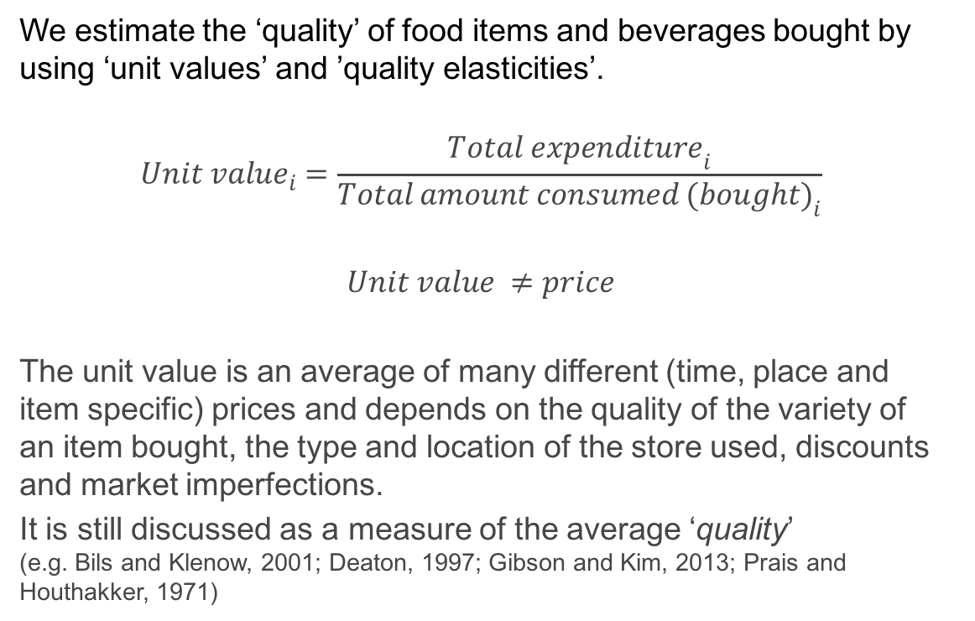

Slide 12
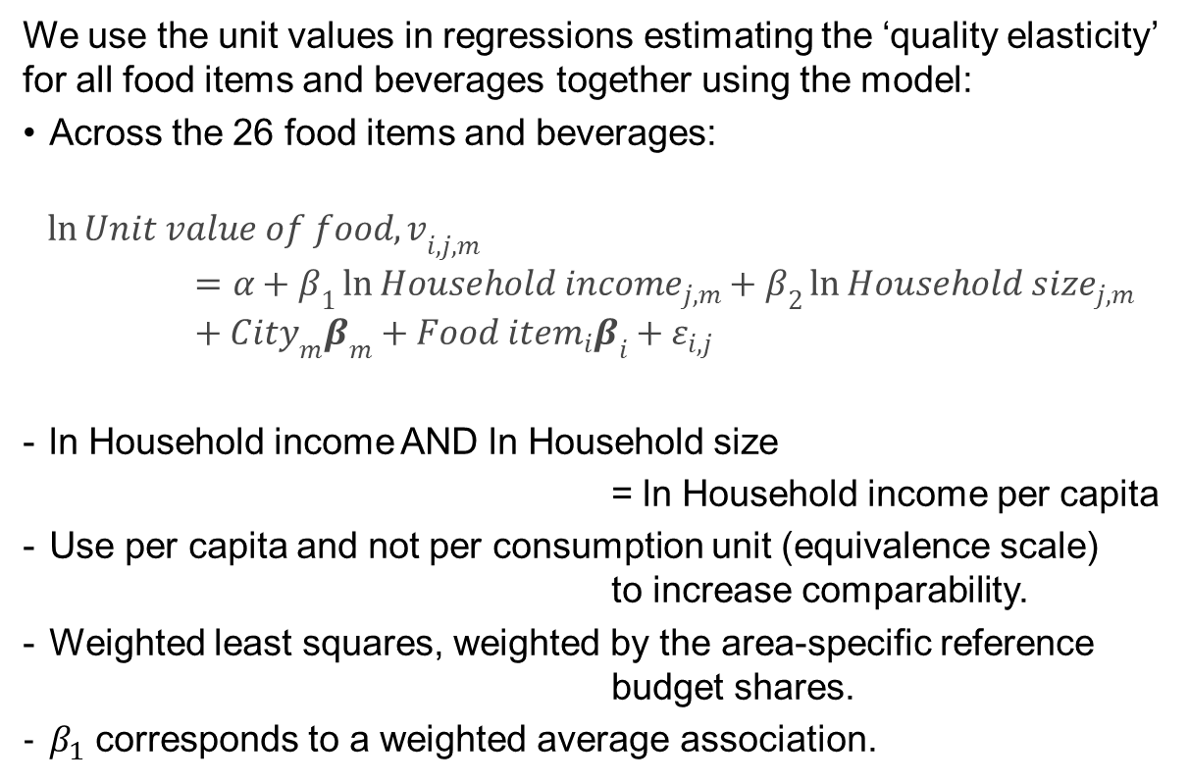

Slide 13
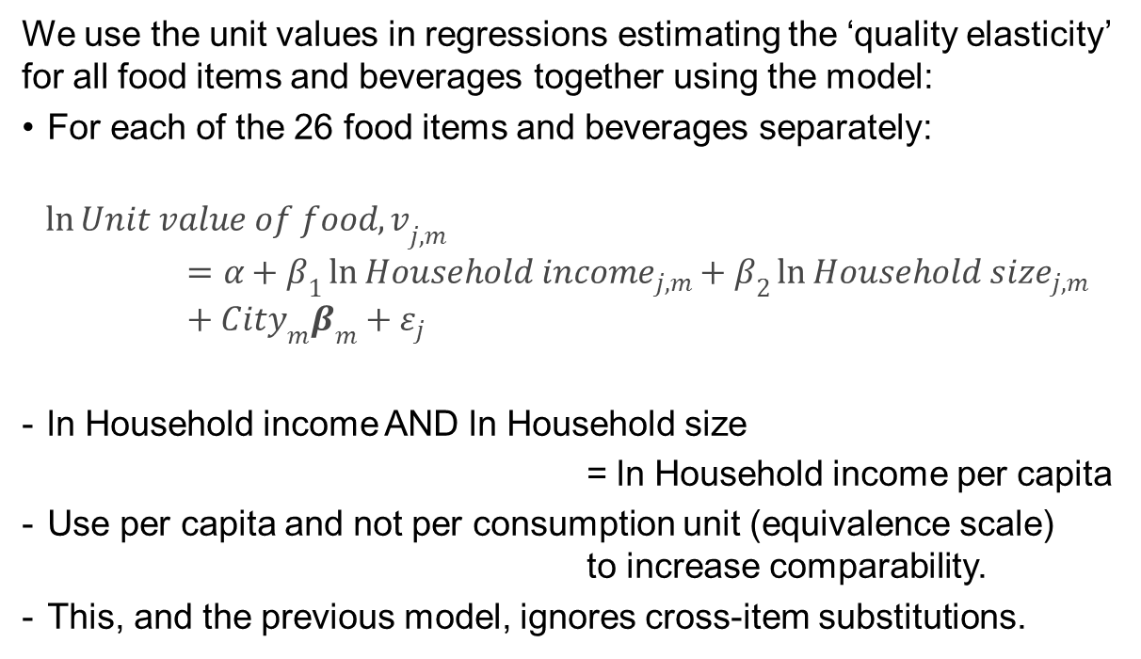

Slide 14
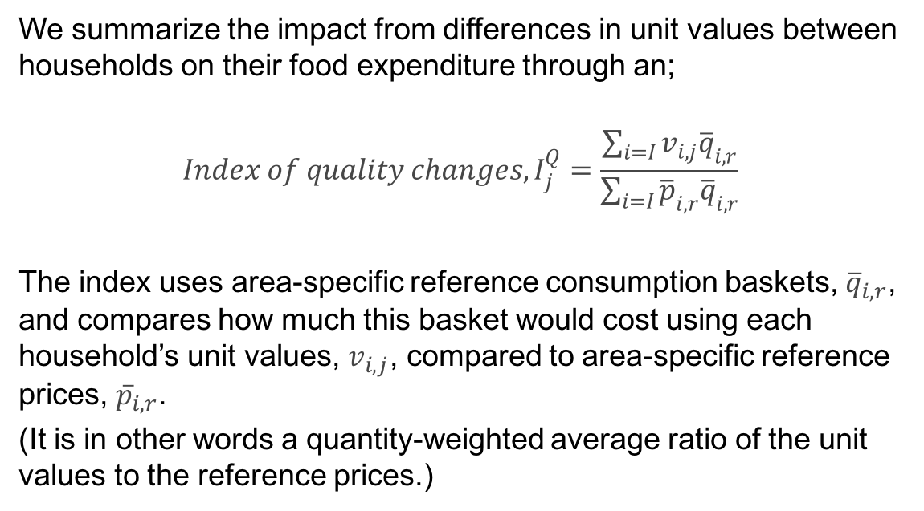

Slide 15
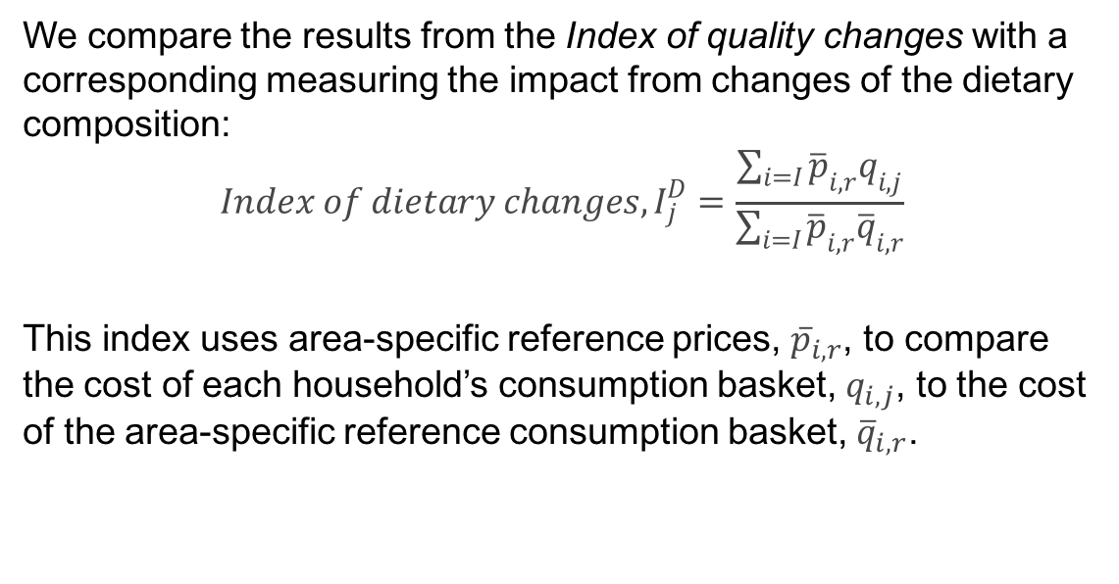

Slide 16
There was a large degree of variation in unit values;
average CV for unit values = 16%
Highest for: beers, liquor, hard rye bread, peas and dry/salted cod
Lowest for: sugar, butter, margarine and wheat flour
There was regional variation in the price levels.

Slide 17
There was a large degree of variation in unit values;
average CV for unit values = 16%
Highest for: beers, liquor, hard rye bread, peas and dry/salted cod
Lowest for: sugar, butter, margarine and wheat flour
There was regional variation in the price levels.
And even larger variation in the dietary composition;
Average CV for consumed quantities = 103%
Highest for: Beers, dry/salted cod, rye flour, preserved beef
Lowest for: Sugar, potatoes, coffee, unskimmed milk
There was substantial regional variations in diet.

Slide 18
There was a large degree of variation in unit values;
average CV for unit values = 16%
Highest for: beers, liquor, hard rye bread, peas and dry/salted cod
Lowest for: sugar, butter, margarine and wheat flour
There was regional variation in the price levels.
And even larger variation in the dietary composition;
Average CV for consumed quantities = 103%
Highest for: Beers, dry/salted cod, rye flour, preserved beef
Lowest for: Sugar, potatoes, coffee, unskimmed milk
There was substantial regional variations in diet.
And also variation in the level of household income;
Average CV for household income = 25%
There was also some regional variation in income and household size.

Slide 19
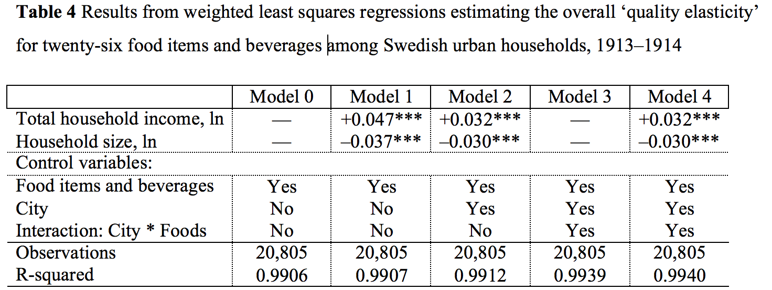
Results:
Statistically significant but substantively weak associations.

Slide 20
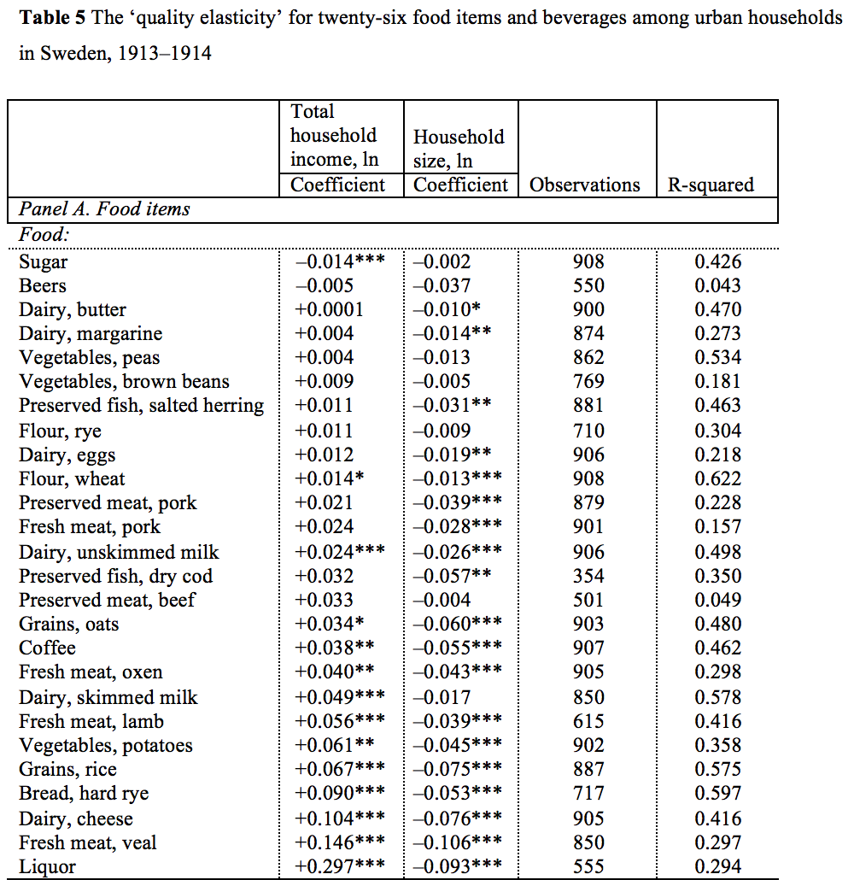
The ‘quality elasticities’ were strongest for luxury foods, such as fresh veal and lamb meat, cheese and liquor.
But, the ‘quality elasticities’ were also strong for staples, such as hard rye bread, potatoes and skimmed milk.

Slide 21
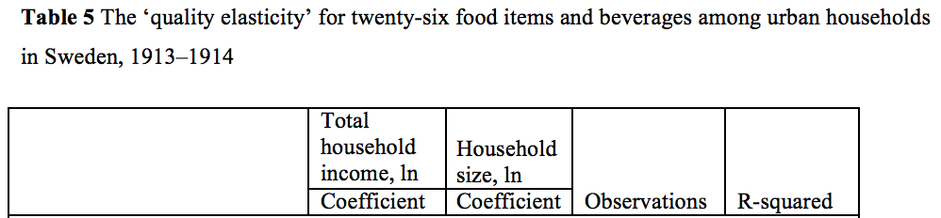
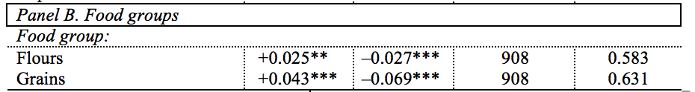
We also analyzed two food groups, flours and grains, for which the aggregates included information on also other types than those reported separately.
The households were increasing the quality of staples and possibly also shifting towards preferred types of staples.

Slide 22
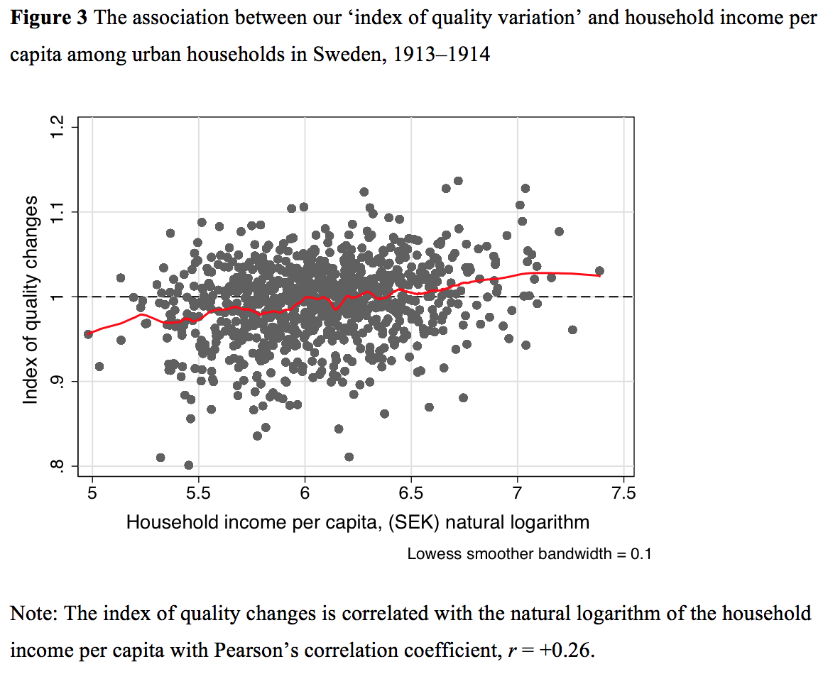
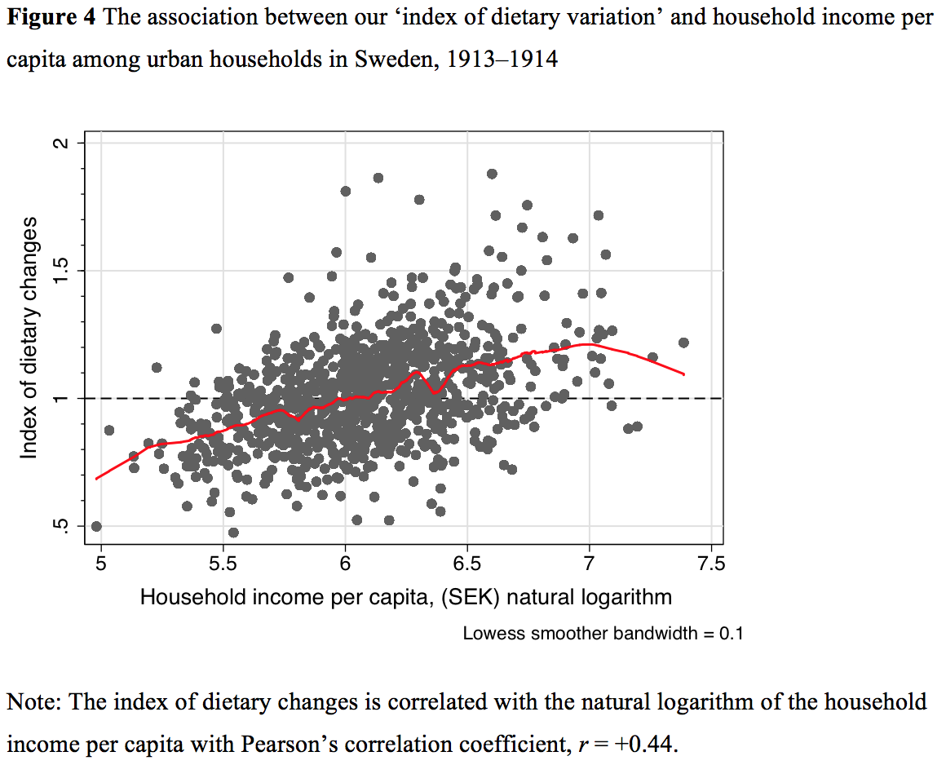
‘Index of quality changes’ ‘Index of dietary changes’
r = +0.26 r = +0.44

Slide 23
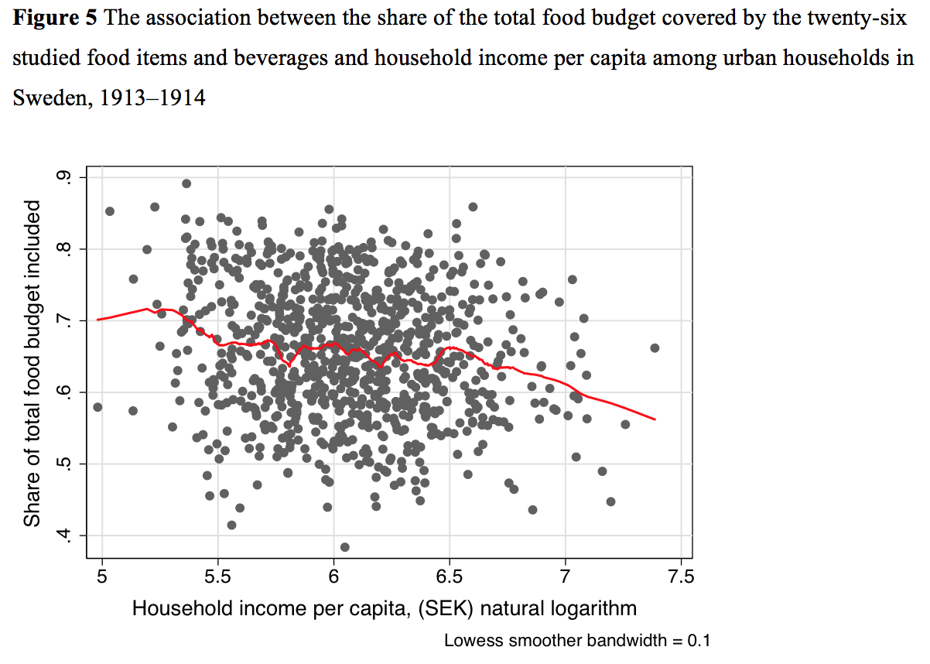
Higher incomes meant higher dietary variability.
r = -0.15

Slide 24
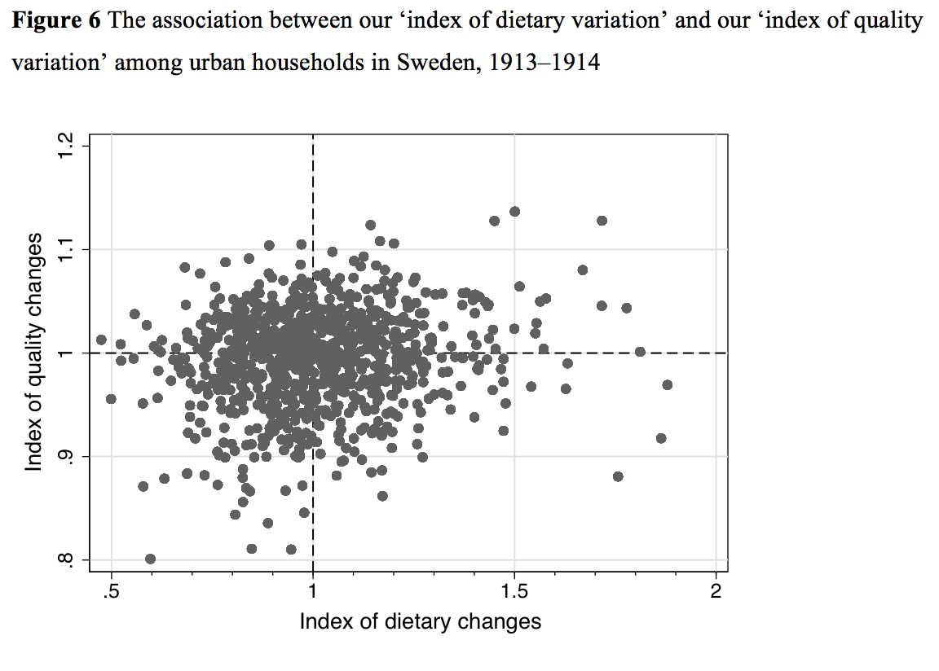
The two behaviors were not strongly associated.
r = +0.15

Slide 25
Conclusions:
The higher-income households spent more per unit on liquor and some luxury foods, such as fresh meats. But they also spent money on raising the quality of several staples, such as potatoes and hard rye bread.
Given the dominance of starchy staples in the diet it is very likely that there were plenty of room to improve on the variability and enjoyability of these diets by spending more on these foods.
The Swedish urban households in the early twentieth century seems to have been in the intermediate step in their ‘nutrition transition’ where they spent their increased incomes on improving on the staples while also starting to shift their diets towards other foods, such as animal products.
Changing the composition of the diet was a more important behavior than changing the quality of foods when adjusting the spending on food.

Slide 26
Thank you for your attention!
The paper will be published in an upcoming special issue of Rivista di Storia Economica.
Stefan Öberg, stefan.oberg@gu.se

Slide 27
Aguiar, Mark, and Erik Hurst. “Life-Cycle Prices and Production.” American Economic Review 97, no. 5 (2007): 1533–59. doi:10.1257/aer.97.5.1533.
Beatty, Timothy K. M. “Do the Poor Pay More for Food? Evidence from the United Kingdom.” American Journal of Agricultural Economics 92, no. 3 (April 1, 2010): 608–21. doi:10.1093/ajae/aaq020.
Bennett, Merrill K. “Wheat in national diets.” Wheat Studies, Wheat Studies from Stanford University, Food Research Institute, 18, no. 2 (1941): 35–76.
Bils, Mark, and Peter J Klenow. “Quantifying Quality Growth.” American Economic Review 91, no. 4 (September 2001): 1006–30. doi:10.1257/aer.91.4.1006.
Broda, Christian, Ephraim Leibtag, and David E. Weinstein. “The Role of Prices in Measuring the Poor’s Living Standards.” The Journal of Economic Perspectives 23, no. 2 (April 1, 2009): 77–97. doi:10.1257/089533009788430580.
Deaton, Angus. The Analysis of Household Surveys: A Microeconometric Approach to Development Policy. Baltimore, Md: Published for the World Bank [by] Johns Hopkins University Press, 1997.
Gibson, John, and Bonggeun Kim. “Do the Urban Poor Face Higher Food Prices? Evidence from Vietnam.” Food Policy 41 (2013): 193–203. doi:10.1016/j.foodpol.2013.05.003.
Grigg, David. “The Starchy Staples in World Food Consumption.” Annals of the Association of American Geographers 86, no. 3 (September 1, 1996): 412–31. doi:10.1111/j.1467-8306.1996.tb01760.x.
Mendoza, Ronald U. “Why Do the Poor Pay More? Exploring the Poverty Penalty Concept.” Journal of International Development 23, no. 1 (2011): 1–28. doi:10.1002/jid.1504.
Prahalad, C. K. The Fortune at the Bottom of the Pyramid. Philadelphia: Wharton School Publ, 2006.
Prais, Sigbert Jon, and Hendrik Samuel Houthakker. The Analysis of Family Budgets. 2. impr., abridged, with a new preface. University of Cambridge. Department of Applied Economics. Monographs 4. Cambridge, 1971.
Socialstyrelsen. Levnadskostnaderna I Sverige 1913-1914. Sveriges Officiella Statistik. Stockholm: Kungl. Boktryckeriet / P. A. Norstedt & Söner, 1917. https://gupea.ub.gu.se/handle/2077/34331.
Socialstyrelsen, K. Levnadskostnaderna I Sverige 1913-1914. Del III. Hushållsräkenskaper. Stockholm: Kungl. Boktryckeriet / P. A. Norstedt & Söner, 1919. https://gupea.ub.gu.se/handle/2077/34331.

